Slide 1
Basic Linux
- Ashutosh Tirmare

Slide 2
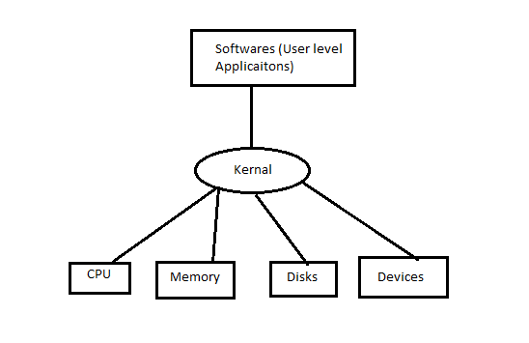
Introduction
Linux is a family of open-source Unix-like operating systems based on the Linux kernel, an operating system kernel first released on September 17, 1991, by Linus Torvalds.
The kernel is a computer program at the core of a computer's operating system and has complete control over everything in the system.

Slide 3
Linux vs windows
Linux
windows
Free source code i.e open source
Secure
Simplified update for all installed Softwares
Light weight
Multiuser and multitasking is very easy
Multiple distributions/flavors are available
Source code is not free or open to all.
Not secure
Not light weight
Limitations to multitasking and multiuser management

Slide 4
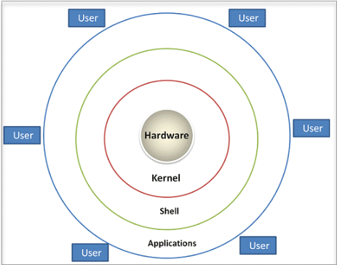
Architecture

Slide 5
Shell
A Shell provides you with an interface to the Unix system. It gathers input from you and executes programs based on that input. When a program finishes executing, it displays that program's output.
Shell is an environment in which we can run our commands, programs, and shell scripts. There are different flavors of a shell, just as there are different flavors of operating systems. Each flavor of shell has its own set of recognized commands and functions
In simple terms SHELL is a program which provides the interface between the user and an operating system (os is also called as kernal)

Slide 6
Types of Shell
The C shell (csh):- It includes helpful programming features like built-in arithmetic and C-like expression syntax.
The Bourne Shell (sh) :- It is the original UNIX shell. It is faster and more preferred. It lacks features for interactive use like the ability to recall previous commands. It also lacks built-in arithmetic and logical expression handling. It is default shell for Solaris OS.
The Korn Shell (ksh):- is a superset of the Bourne shell.So it supports everything in the Bourne shell.It has interactive features. It includes features like built-in arithmetic and C-like arrays, functions, and string-manipulation facilities.It is faster than C shell. It is compatible with script written for C shell.
Bourne Again Shell (bash) :- It is compatible to the Bourne shell. It includes features from Korn and Bourne shell.

Slide 7
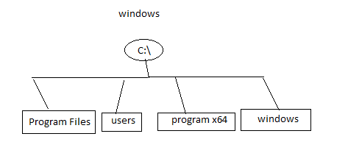
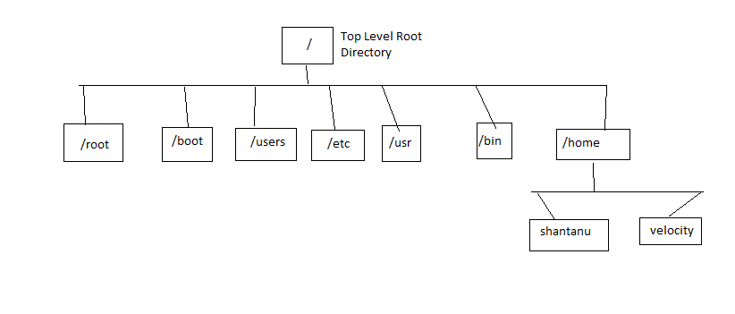
File system Hierarchy
windows
Linux

